Slide 1
IT Professional Environment: Law, Ethics and Privacy
Week 6:
Lecturer: Dr. Farshid Keivanian

Slide 2
Cybersecurity Fundamentals
Introduction: Cybersecurity is the practice of protecting systems, networks, and programs from digital attacks. These attacks typically aim to access, change, or destroy sensitive information, extort money from users, or disrupt normal business processes.

Slide 3
Cybersecurity Fundamentals
Practical Scenario: Imagine you are the IT Security Manager at Melbourne Banking Corp. Recently, there has been a surge in digital attacks targeting financial institutions, aiming to steal customer data and disrupt online services. You need to implement a robust cybersecurity plan to protect the organization.
Class Discussion Question: What fundamental cybersecurity measures should Melbourne Banking Corp. take to safeguard its data and services?
Responses:
Implement multi-factor authentication (MFA) for all employees and customers.
Regularly update and patch software and systems.
Conduct regular security audits and employee training sessions.

Slide 4
Cybersecurity Fundamentals
Follow-Up Question: Can you think of a real-life example where a lack of fundamental cybersecurity measures led to a major data breach?
A real-life example where a lack of fundamental cybersecurity measures led to a major data breach is the Equifax data breach in 2017. Equifax, one of the largest credit reporting agencies in the U.S., suffered a massive data breach due to its failure to patch a known vulnerability in one of its web applications. The attackers exploited this vulnerability to gain access to the personal information of approximately 147 million people, including names, Social Security numbers, birth dates, addresses, and, in some cases, driver’s license numbers.

Slide 5
Cybersecurity Fundamentals
Follow-Up Question: Can you think of a real-life example where a lack of fundamental cybersecurity measures led to a major data breach?
The breach occurred because Equifax did not implement essential cybersecurity measures, such as timely patching of software vulnerabilities, regular security audits, and robust monitoring systems. Additionally, there was inadequate encryption for sensitive data, which made the compromised information easily accessible to hackers. This incident highlights the importance of fundamental cybersecurity practices like patch management, vulnerability assessments, and data encryption to prevent such breaches from occurring. It also underscores the need for organizations to prioritize cybersecurity to protect sensitive information and maintain trust with their customers.

Slide 6
Cryptography
Introduction: Cryptography is the process of converting plain text into coded text to secure data from unauthorized access. It plays a crucial role in maintaining data integrity, confidentiality, and authenticity.

Slide 7
Cryptography
Practical Scenario: You are working for Sydney HealthTech, a company providing online health services. To ensure patient privacy, you need to encrypt all sensitive health data both in transit and at rest.
Class Discussion Question: Why is cryptography essential for a company like Sydney HealthTech, and what types of cryptography could they use?
Responses:
Protects sensitive patient data from unauthorized access.
Ensures data integrity and confidentiality.
Types of cryptography: symmetric encryption (AES), asymmetric encryption (RSA).

Slide 8
Cryptography
Multiple Choice Question: Which cryptographic method is commonly used to secure data in transit?
A) Plaintext
B) RSA Encryption
C) Data Masking
D) SQL Injection

Slide 9
Security Technologies
Introduction: Security technologies are tools and systems designed to protect digital assets from threats and unauthorized access. Common technologies include firewalls, intrusion detection systems (IDS), and antivirus software.

Slide 10
Security Technologies
Practical Scenario: As a cybersecurity consultant for Canberra Tech Solutions, you need to recommend a suite of security technologies to protect the company’s network and data from both external and internal threats.
Class Discussion Question: What security technologies would you recommend for Canberra Tech Solutions, and why?
Responses:
Firewalls to block unauthorized access.
Intrusion Detection Systems (IDS) to monitor and alert about suspicious activities.
Antivirus software to detect and remove malicious software.

Slide 11
Security Technologies
Follow-Up Question: How would you prioritize these technologies based on a limited budget?
When prioritizing security technologies on a limited budget, it is crucial to focus on the tools that provide the most comprehensive protection against the most significant threats. Here's how you might prioritize:
Firewalls: Firewalls should be the top priority as they form the first line of defense against unauthorized access to the network. They help block potentially malicious traffic and control incoming and outgoing network traffic based on security rules. Since firewalls can protect against a wide range of threats, investing in a robust firewall solution is essential.

Slide 12
Security Technologies
Follow-Up Question: How would you prioritize these technologies based on a limited budget?
2. Intrusion Detection Systems (IDS): The next priority would be an Intrusion Detection System. While firewalls block known threats, IDS is critical for detecting and alerting about suspicious activities that may bypass the firewall, such as insider threats or sophisticated attacks. Implementing IDS provides an added layer of security by monitoring network traffic in real-time and identifying anomalies or patterns that could indicate a security breach.

Slide 13
Security Technologies
Follow-Up Question: How would you prioritize these technologies based on a limited budget?
3. Antivirus Software: Antivirus software should also be included, but it might be prioritized slightly lower than firewalls and IDS, especially on a tight budget. While antivirus software is essential for detecting and removing known malware, many modern threats may not be caught by traditional antivirus solutions alone. Therefore, antivirus tools should complement firewalls and IDS but not replace them.

Slide 14
Security Technologies
Follow-Up Question: How would you prioritize these technologies based on a limited budget?
By focusing first on firewalls and IDS, Canberra Tech Solutions can establish strong perimeter security and continuous monitoring. Antivirus software should still be implemented but can be managed more cost-effectively, possibly through centralized or free solutions if the budget is particularly tight. This prioritization ensures the most critical layers of defense are in place while maximizing the value of the available budget.

Slide 15
Cyberattacks
Introduction: Cyberattacks are malicious attempts by hackers to damage or disrupt computer systems, steal data, or gain unauthorized access to digital assets. Common types include phishing, malware, ransomware, and Distributed Denial of Service (DDoS) attacks.

Slide 16
Cyberattacks
Practical Scenario: You are the Head of IT Security at Brisbane Energy Corp. Recently, the company experienced a ransomware attack that encrypted all critical data, and the attackers are demanding a ransom for the decryption key.
Class Discussion Question: What steps should Brisbane Energy Corp. take immediately after a ransomware attack?
Responses:
Disconnect affected systems from the network.
Report the attack to relevant authorities.
Implement data recovery from backups if available.
Conduct a thorough investigation to identify the source of the attack.

Slide 17
Cyberattacks
Multiple Choice Question: What is the primary goal of a ransomware attack?
A) To steal customer data
B) To damage physical infrastructure
C) To demand payment for data decryption
D) To improve system performance

Slide 18
Cybersecurity Awareness and Best Practices
Introduction: Cybersecurity awareness involves understanding the various threats that exist in the digital space and following best practices to protect against them. This includes recognizing phishing attempts, using strong passwords, and updating software regularly.

Slide 19
Cybersecurity Awareness and Best Practices
Practical Scenario: As an employee at Sydney Retail Group, you receive an email that appears to be from a known vendor asking for sensitive financial information. You are unsure whether the email is legitimate or a phishing attempt.
Class Discussion Question: What steps should you take to verify the authenticity of the email and protect yourself from potential phishing?
Responses:
Do not click on any links or download attachments.
Verify the sender's email address and check for any suspicious signs.
Contact the vendor directly through official channels to confirm the request.

Slide 20
Cybersecurity Awareness and Best Practices
Follow-Up Question: Can you think of other common phishing tactics you should be aware of in your daily digital interactions?
Yes, there are several other common phishing tactics to be aware of in daily digital interactions:
Spoofed Websites: Phishers often create fake websites that look almost identical to legitimate sites. They might send emails or messages with links directing you to these sites to steal your login credentials or personal information. Always double-check the URL for subtle misspellings or unusual domain extensions.

Slide 21
Cybersecurity Awareness and Best Practices
2. Urgency or Fear Tactics: Phishing emails often create a sense of urgency or fear to prompt immediate action, such as claiming that your account has been compromised or that you must verify your information urgently to avoid penalties. Be cautious of messages that pressure you to act quickly without giving you time to think.
3. Unexpected Attachments: Phishers frequently send unexpected attachments that may appear harmless, like invoices or documents, but contain malware. Never open attachments from unknown or unverified senders, and even with known senders, it's best to confirm directly before opening.

Slide 22
Cybersecurity Awareness and Best Practices
4. Impersonation of Trusted Contacts: Attackers might impersonate a trusted contact or colleague whose email account has been compromised. They could send seemingly normal requests, like asking for sensitive information or money transfers. Always verify such requests through a different communication channel.
5. Social Media Phishing: Scammers often use social media platforms to gather personal information or send malicious links through direct messages. Be cautious about accepting friend requests or engaging with unknown accounts, and avoid clicking on unsolicited links.

Slide 23
Cybersecurity Awareness and Best Practices
By being aware of these common tactics, you can better protect yourself from falling victim to phishing attempts and other online scams. Always remain vigilant, trust your instincts, and take the time to verify the legitimacy of any suspicious communication.

Slide 24
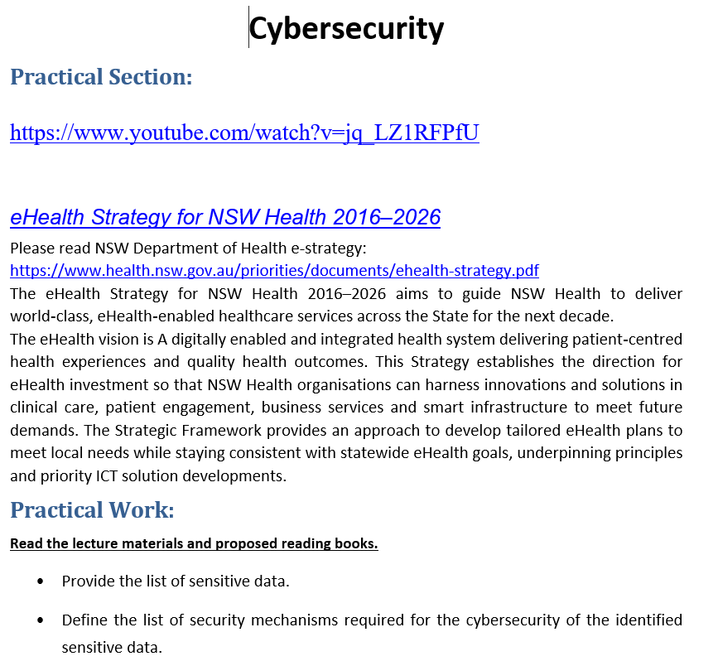
Tutorial Week 6

Slide 25
Tutorial Week 6
List of Sensitive Data:
Patient Information: Personal details such as names, addresses, contact information, and health history.
Electronic Medical Records (eMRs): Medical histories, treatment plans, test results, and medication records.
Financial Information: Billing data, payment details, and insurance information.
Clinical Data: Diagnoses, procedures, laboratory results, and imaging data.
Telehealth Data: Video consultations, remote monitoring data, and communication records.

Slide 26
Tutorial Week 6
6. Research Data: Data used in clinical trials or studies, which may include identifiable patient information.
7. Data from Medical Devices: Information generated by wearables, implantables, and diagnostic tools.
8. Staff Information: Employee records, professional credentials, and HR data.
9. Infrastructure and Security Logs: Information related to network traffic, system access logs, and security alerts.

Slide 27
Tutorial Week 6
List of Required Security Mechanisms:
Encryption: Encrypting data at rest and in transit to protect sensitive information from unauthorized access.
Multi-Factor Authentication (MFA): Requiring multiple forms of verification (such as passwords and biometric data) to access systems.
Access Controls: Implementing role-based access control (RBAC) to ensure only authorized personnel have access to specific data.
Intrusion Detection and Prevention Systems (IDPS): Monitoring network traffic for suspicious activity and preventing potential breaches.

Slide 28
Tutorial Week 6
5. Data Loss Prevention (DLP) Tools: Monitoring data transfer and preventing unauthorized sharing or leakage of sensitive information.
6. Endpoint Security: Deploying antivirus software, firewalls, and endpoint detection and response (EDR) solutions to secure devices accessing the network.
7. Regular Audits and Monitoring: Conducting security audits and continuous monitoring to detect and respond to vulnerabilities and incidents.
8. Secure Messaging and Communication Tools: Ensuring all communication, especially involving patient data, is done through secure, encrypted channels.

Slide 29
Tutorial Week 6
9. Network Segmentation: Separating networks to limit access and contain potential breaches within specific areas.
10. Backup and Disaster Recovery Plans: Regularly backing up data and having a clear recovery strategy to protect against data loss due to cyber-attacks or system failures.
11. Security Awareness Training: Regular training programs for employees on identifying phishing attempts, using secure passwords, and maintaining best practices.
12. Patch Management: Keeping software and systems up-to-date to protect against vulnerabilities.

Slide 30
Tutorial Week 6
These security mechanisms collectively ensure a robust cybersecurity framework to protect the sensitive data identified in the document and the video explanation.

